Slide 1
USER INFO MANAGEMENT
BIO DATA MANAGEMENT SYSTEM
by php

Slide 2
Team PHOENIX
TEAM LEADER :
- Suganya R
TEAM MEMBERS :
Renuka S
Abith Jeri Vinith J
Sabinlal R L
Notes:
-Add team details with name and qualification,e-mail,phone no and place

Slide 3
Database Design
.
Basic Details
User Details
Education Details
CRUD
Personal details
Experience Details
Technology known
Notes:
Get the database design from the phpmyadmin or from SRS document

Slide 4
Database Design - User Details
.
Name
CRUD
User Details
User Name
Email
Mobile

Slide 5
Database Design - Basic Details
.
User code
Name
Address
CRUD
Basic Details
Email
Mobile
Profile
Objective
Declaration

Slide 6
Database Design – Education Details
User code
Course Name
CRUD
Education Details
University
College
PassYear
Percentage

Slide 7
Database Design - Experience Details
User Code
CRUD
Experience Details
Organization Name
Experience
Role

Slide 8
Database Design - Technology Details
User Code
CRUD
Technlogy Details
Experience type
Experience Detail

Slide 9
Database Design - Personal Details
User Code
CRUD
Personal Details
Personal Type
Personal Detail

Slide 10
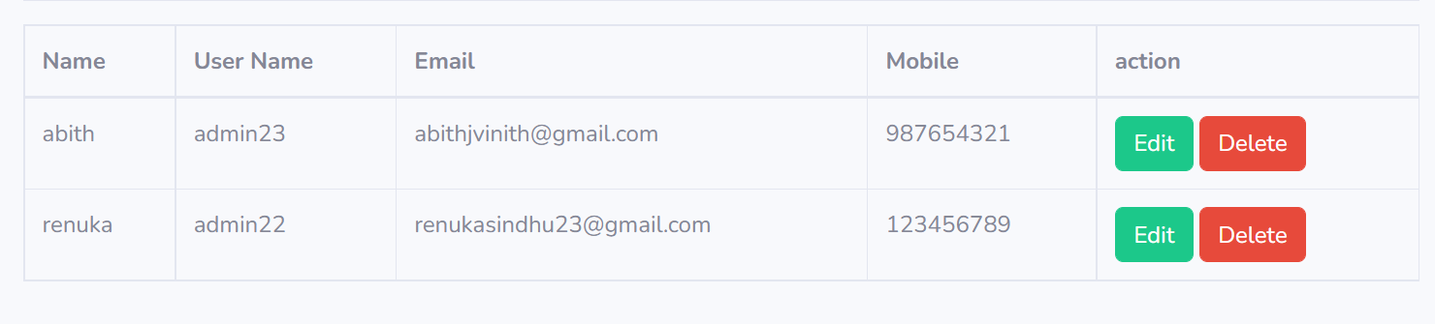
Form Design – User Details
User Details:
Notes:
Get the form design from the phpmyadmin or from SRS document

Slide 11
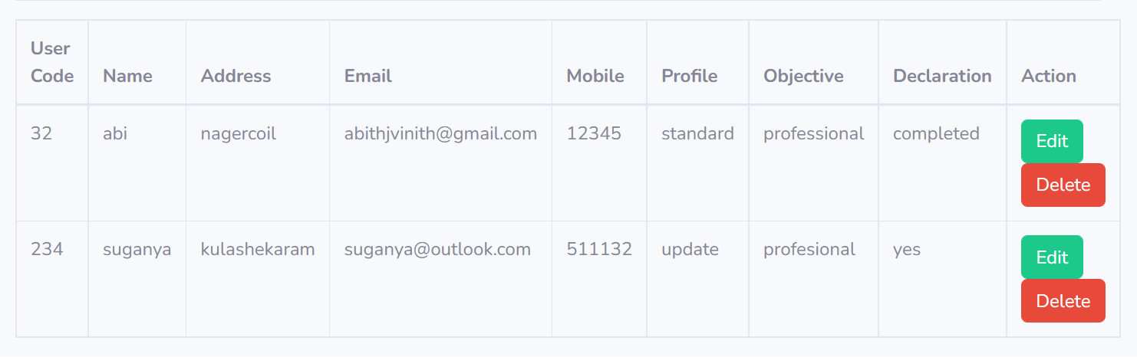
Form Design – Basic Details
Basic Details:

Slide 12
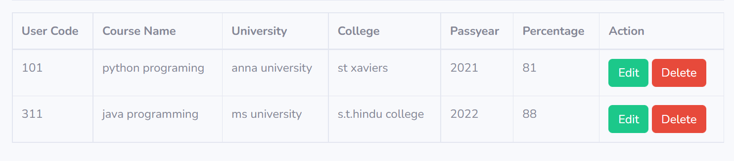
Form Design - Education Details
Education Details:

Slide 13
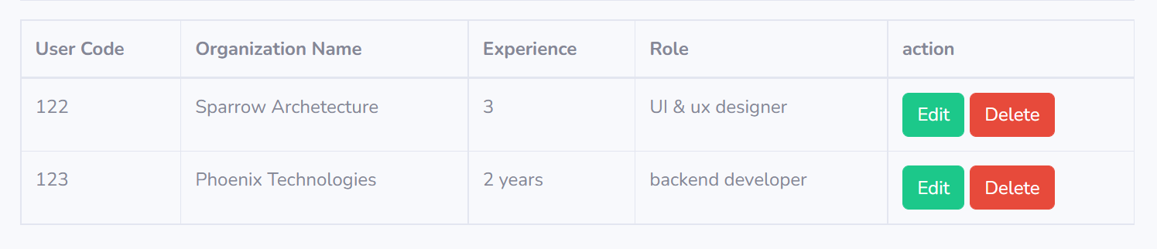
Form Design – Experience Setting
Experience Setting:

Slide 14

Form Design – Technology known setting
Technology known setting:

Slide 15
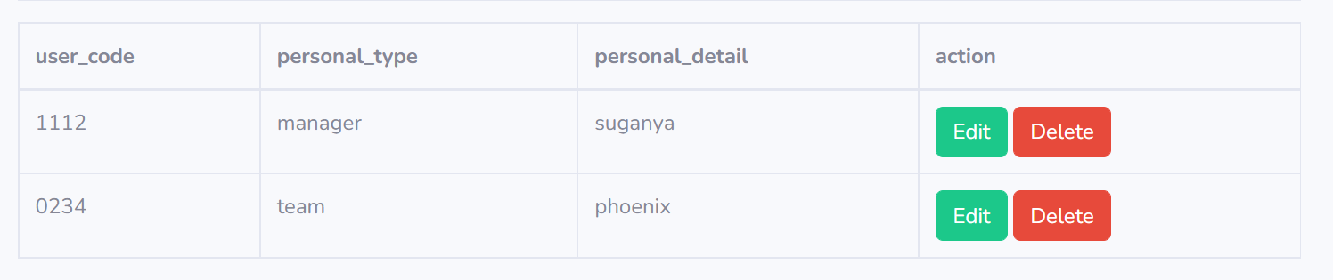
Form Design – Personal detail setting
Personal detail setting

Slide 16
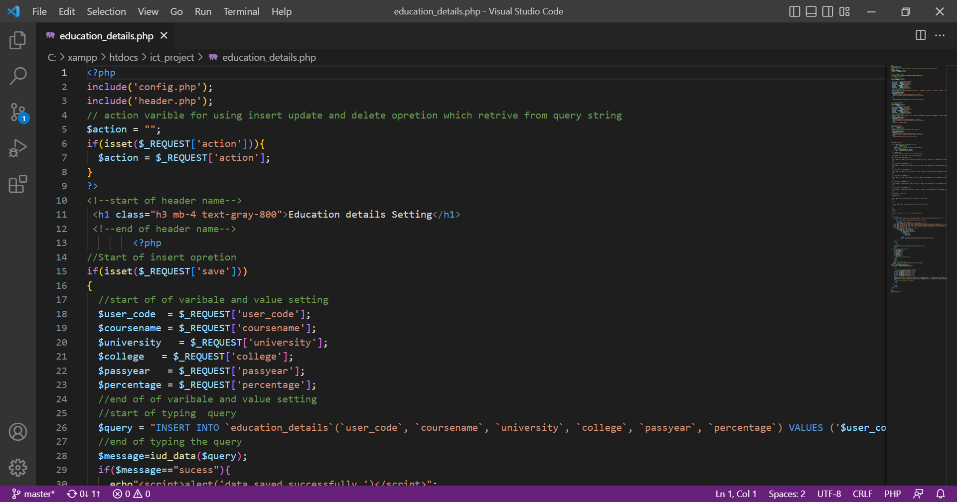
Sample Source code
The source code is taken from the getbootstrap website.
Install via npm :
npm i startbootstrap-sb-admin-2

Slide 17
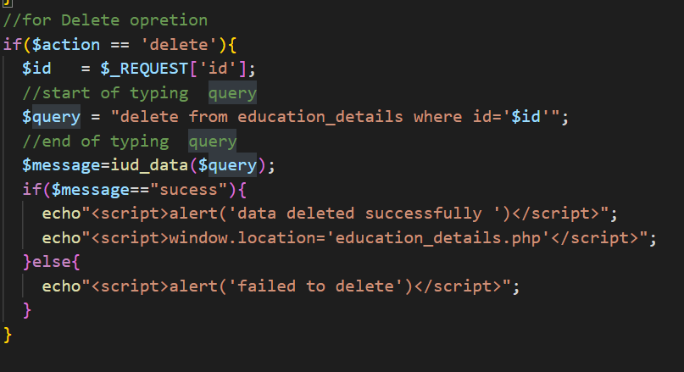
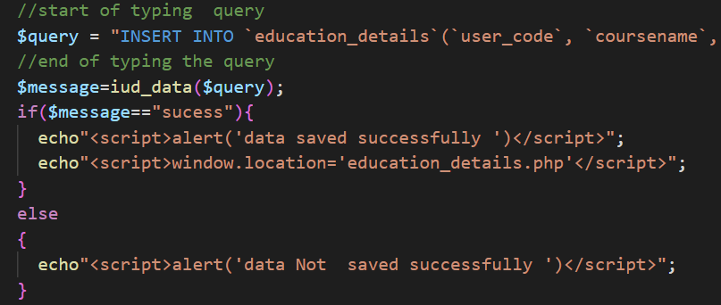
Sample Source Code
Insert Queries :
INSERT INTO ‘sample name’( ) VALUES ( );
Delete Queries:
DELETE FROM sample_name WHERE id=‘$id’”;

Slide 18
TEAM MEMBER - 1

Slide 19
Forms & Database Design
The database design is taken from the bootstrap template.
We modified those design, according to the need of the user.
There are six types of forms presented. Namely:
- User details - Experience settings
- Basic details - Technology known setting
- Education details - Personal setting
Notes:
Explain Form and database worked with

Slide 20
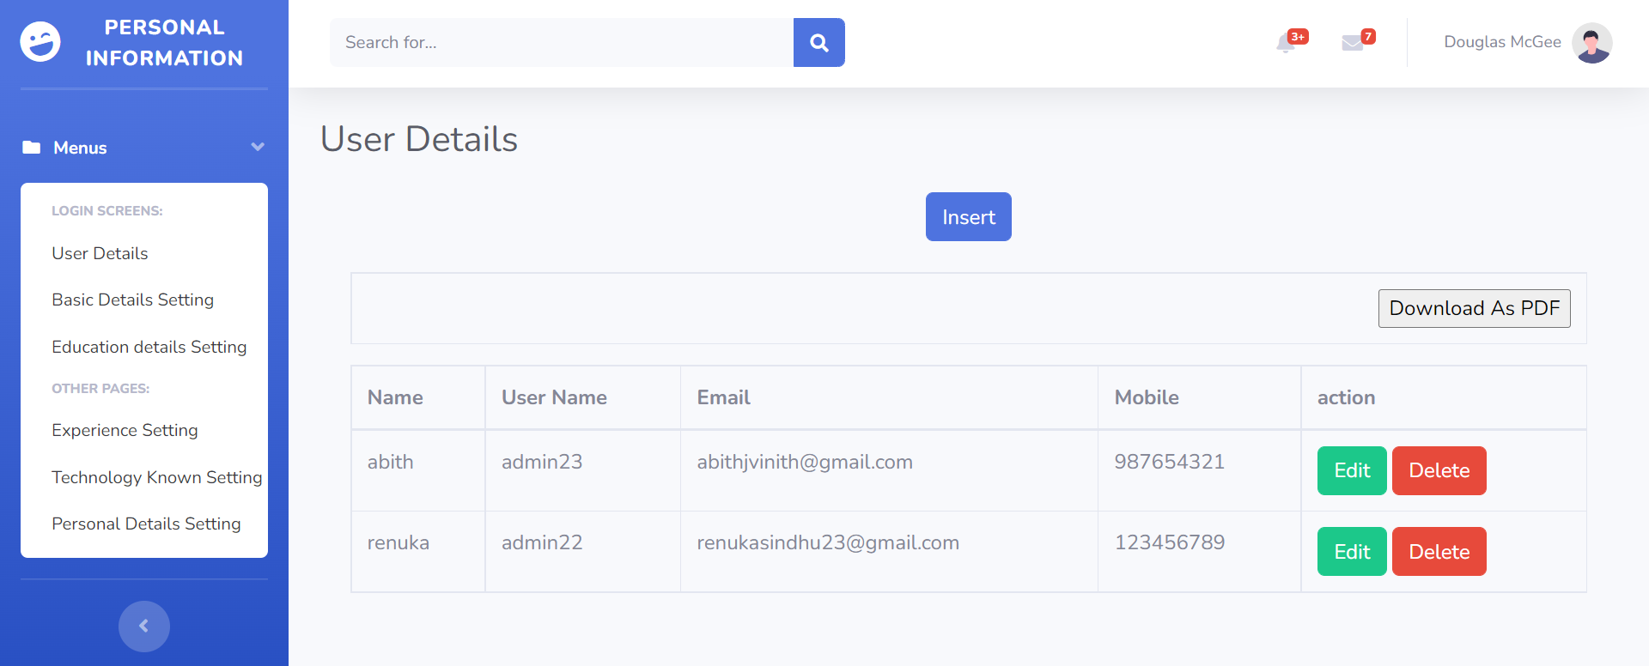
Form Design
.

Slide 21
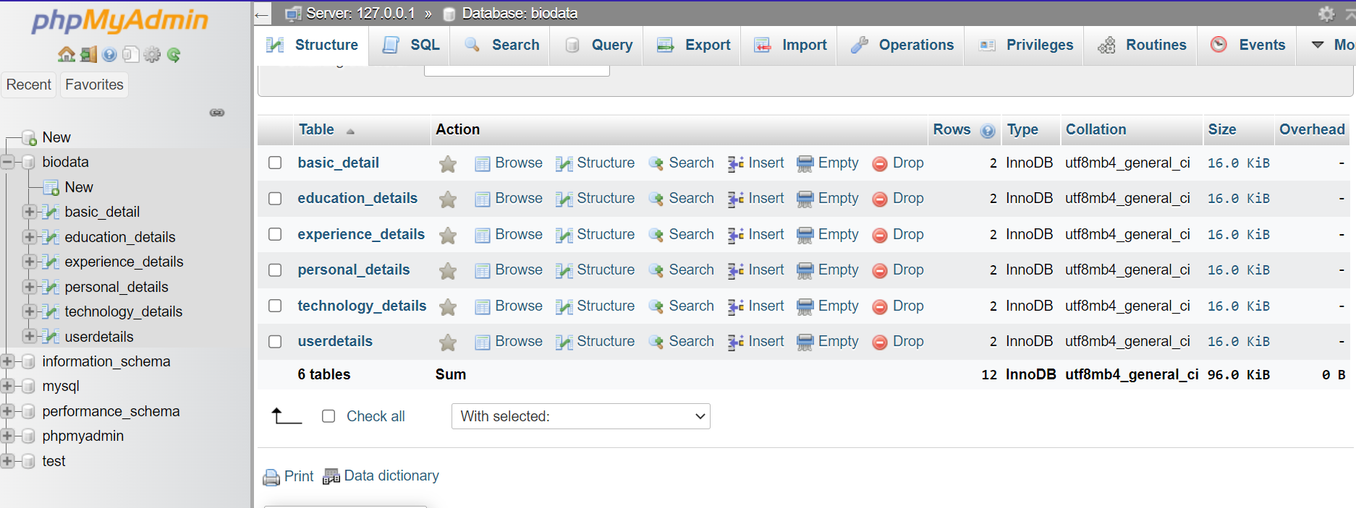
Database Design

Slide 22
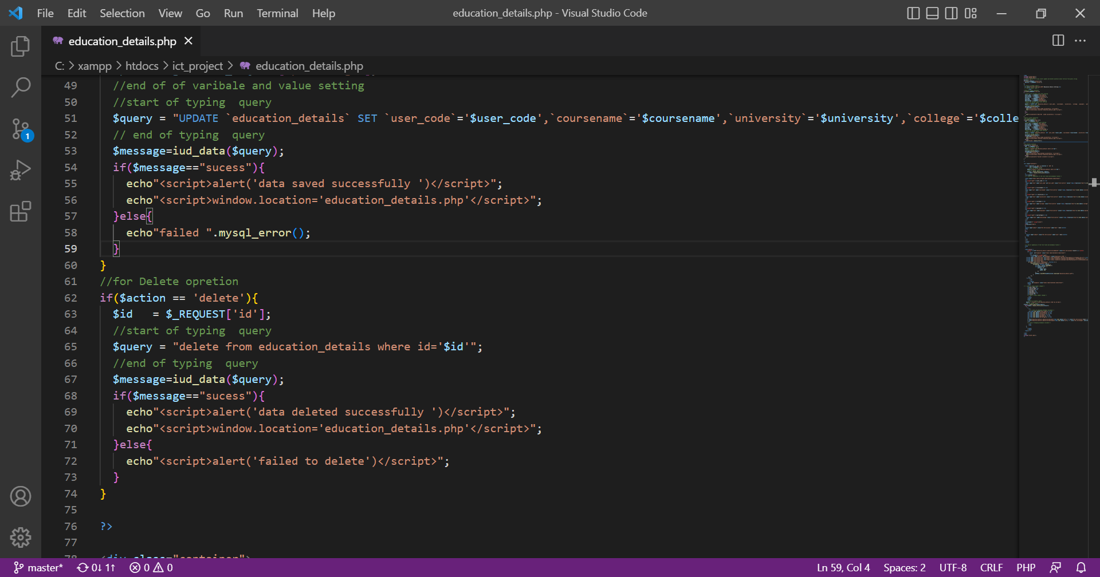
Problem faced:
When we work on the “delete operation” we faced an error.
The error was when we tried to delete a data from the server, it just remains same without deleting the data from server.

Slide 23
Solution to the problem
The error was founded in the delete query.
We fixed the bug by inserting “id” in the delete query.
DELETE FROM sample WHERE id=‘$id’
Notes:
Explain how attained the solution

Slide 24
Sample Source code
Notes:
Explain how attained the solution

Slide 25
TEAM MEMBER -2

Slide 26

Form Design

Slide 27
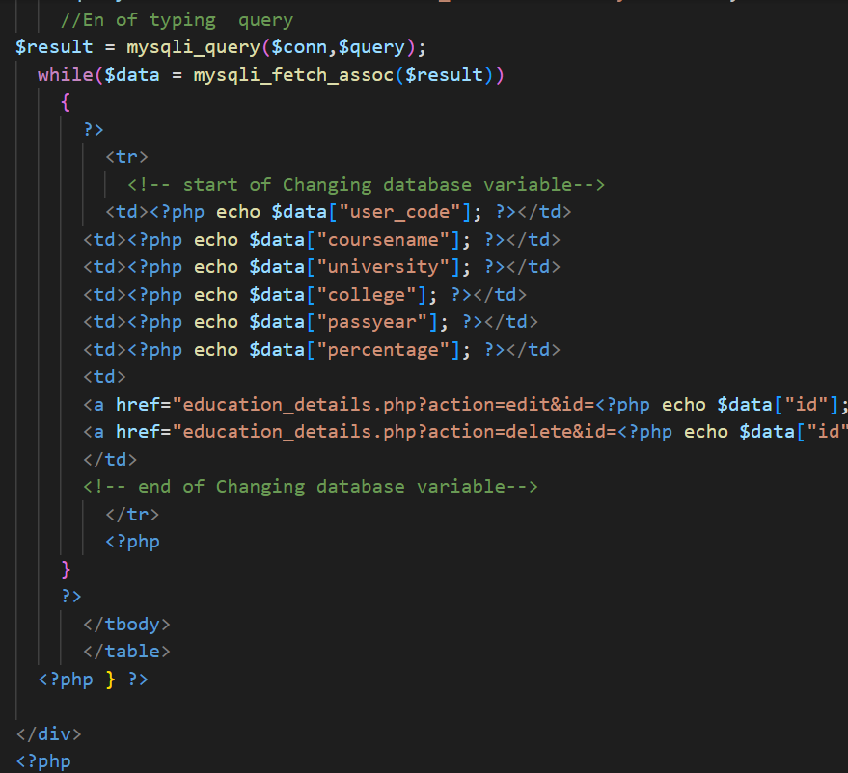
Problem faced:
When we do location path on our page, it works finely but after completing the operation it just redirects to the first page.

Slide 28
Solution to the problem
The error was founded in the location path bottom line.
We fixed the bug by inserting the specific location at the bottom the query.
<a href="education_details.php?action=delete&id=<?php echo $data["id"];
Notes:
Explain how attained the solution

Slide 29

Sample Source code
Notes:
Explain how attained the solution

Slide 30
Thank You TEAM PHOENIX

